Slide 1
Blender Project
Classroom
Elí Emmanuel Linares Romero A00815654
Juan Luis Flores Garza A01280767
Alejandro de la Rosa Cortés A01381412

Slide 2
Introduction

Slide 3
Introduction
We design a classroom to show an imaginary classroom where children have access to computers and a high quality education with good infrastructure.
The reality is that many children in Mexico does not have access to a high quality education, to a well prepared teacher, to a nice classroom and to computers and internet.
We think we need to change that situation and we want to start dreaming with that.

Slide 4
Modelling

Slide 5
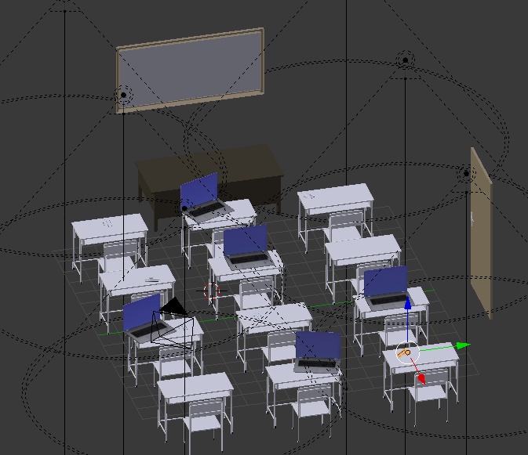
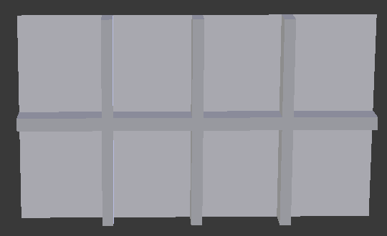
Original Models
List models developed by the team
Classroom
Board
Desktop
Pencil & Pen
Door
Windows

Slide 6
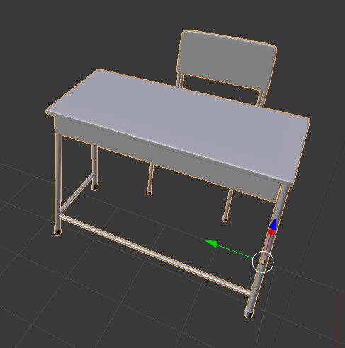
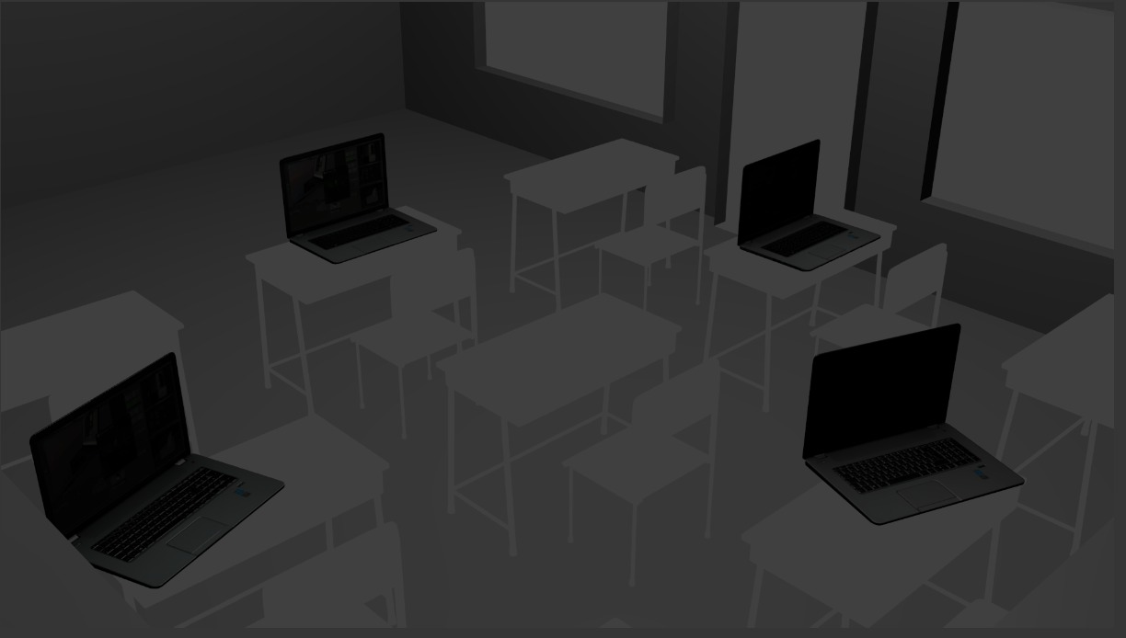
List Imported models
Computers
Door Knob
Chair

Slide 7
Layout and Composition
We have 4 lines of chairs and tables, some laptops were placed on the tables, and we have the capability to view the outside of the room.
We try to make a traditional layout for a classroom where the teacher is in front of the class writing on the whiteboard and the children are in lines. We also put laptops to represent the way we take classes nowadays at Tec.

Slide 8
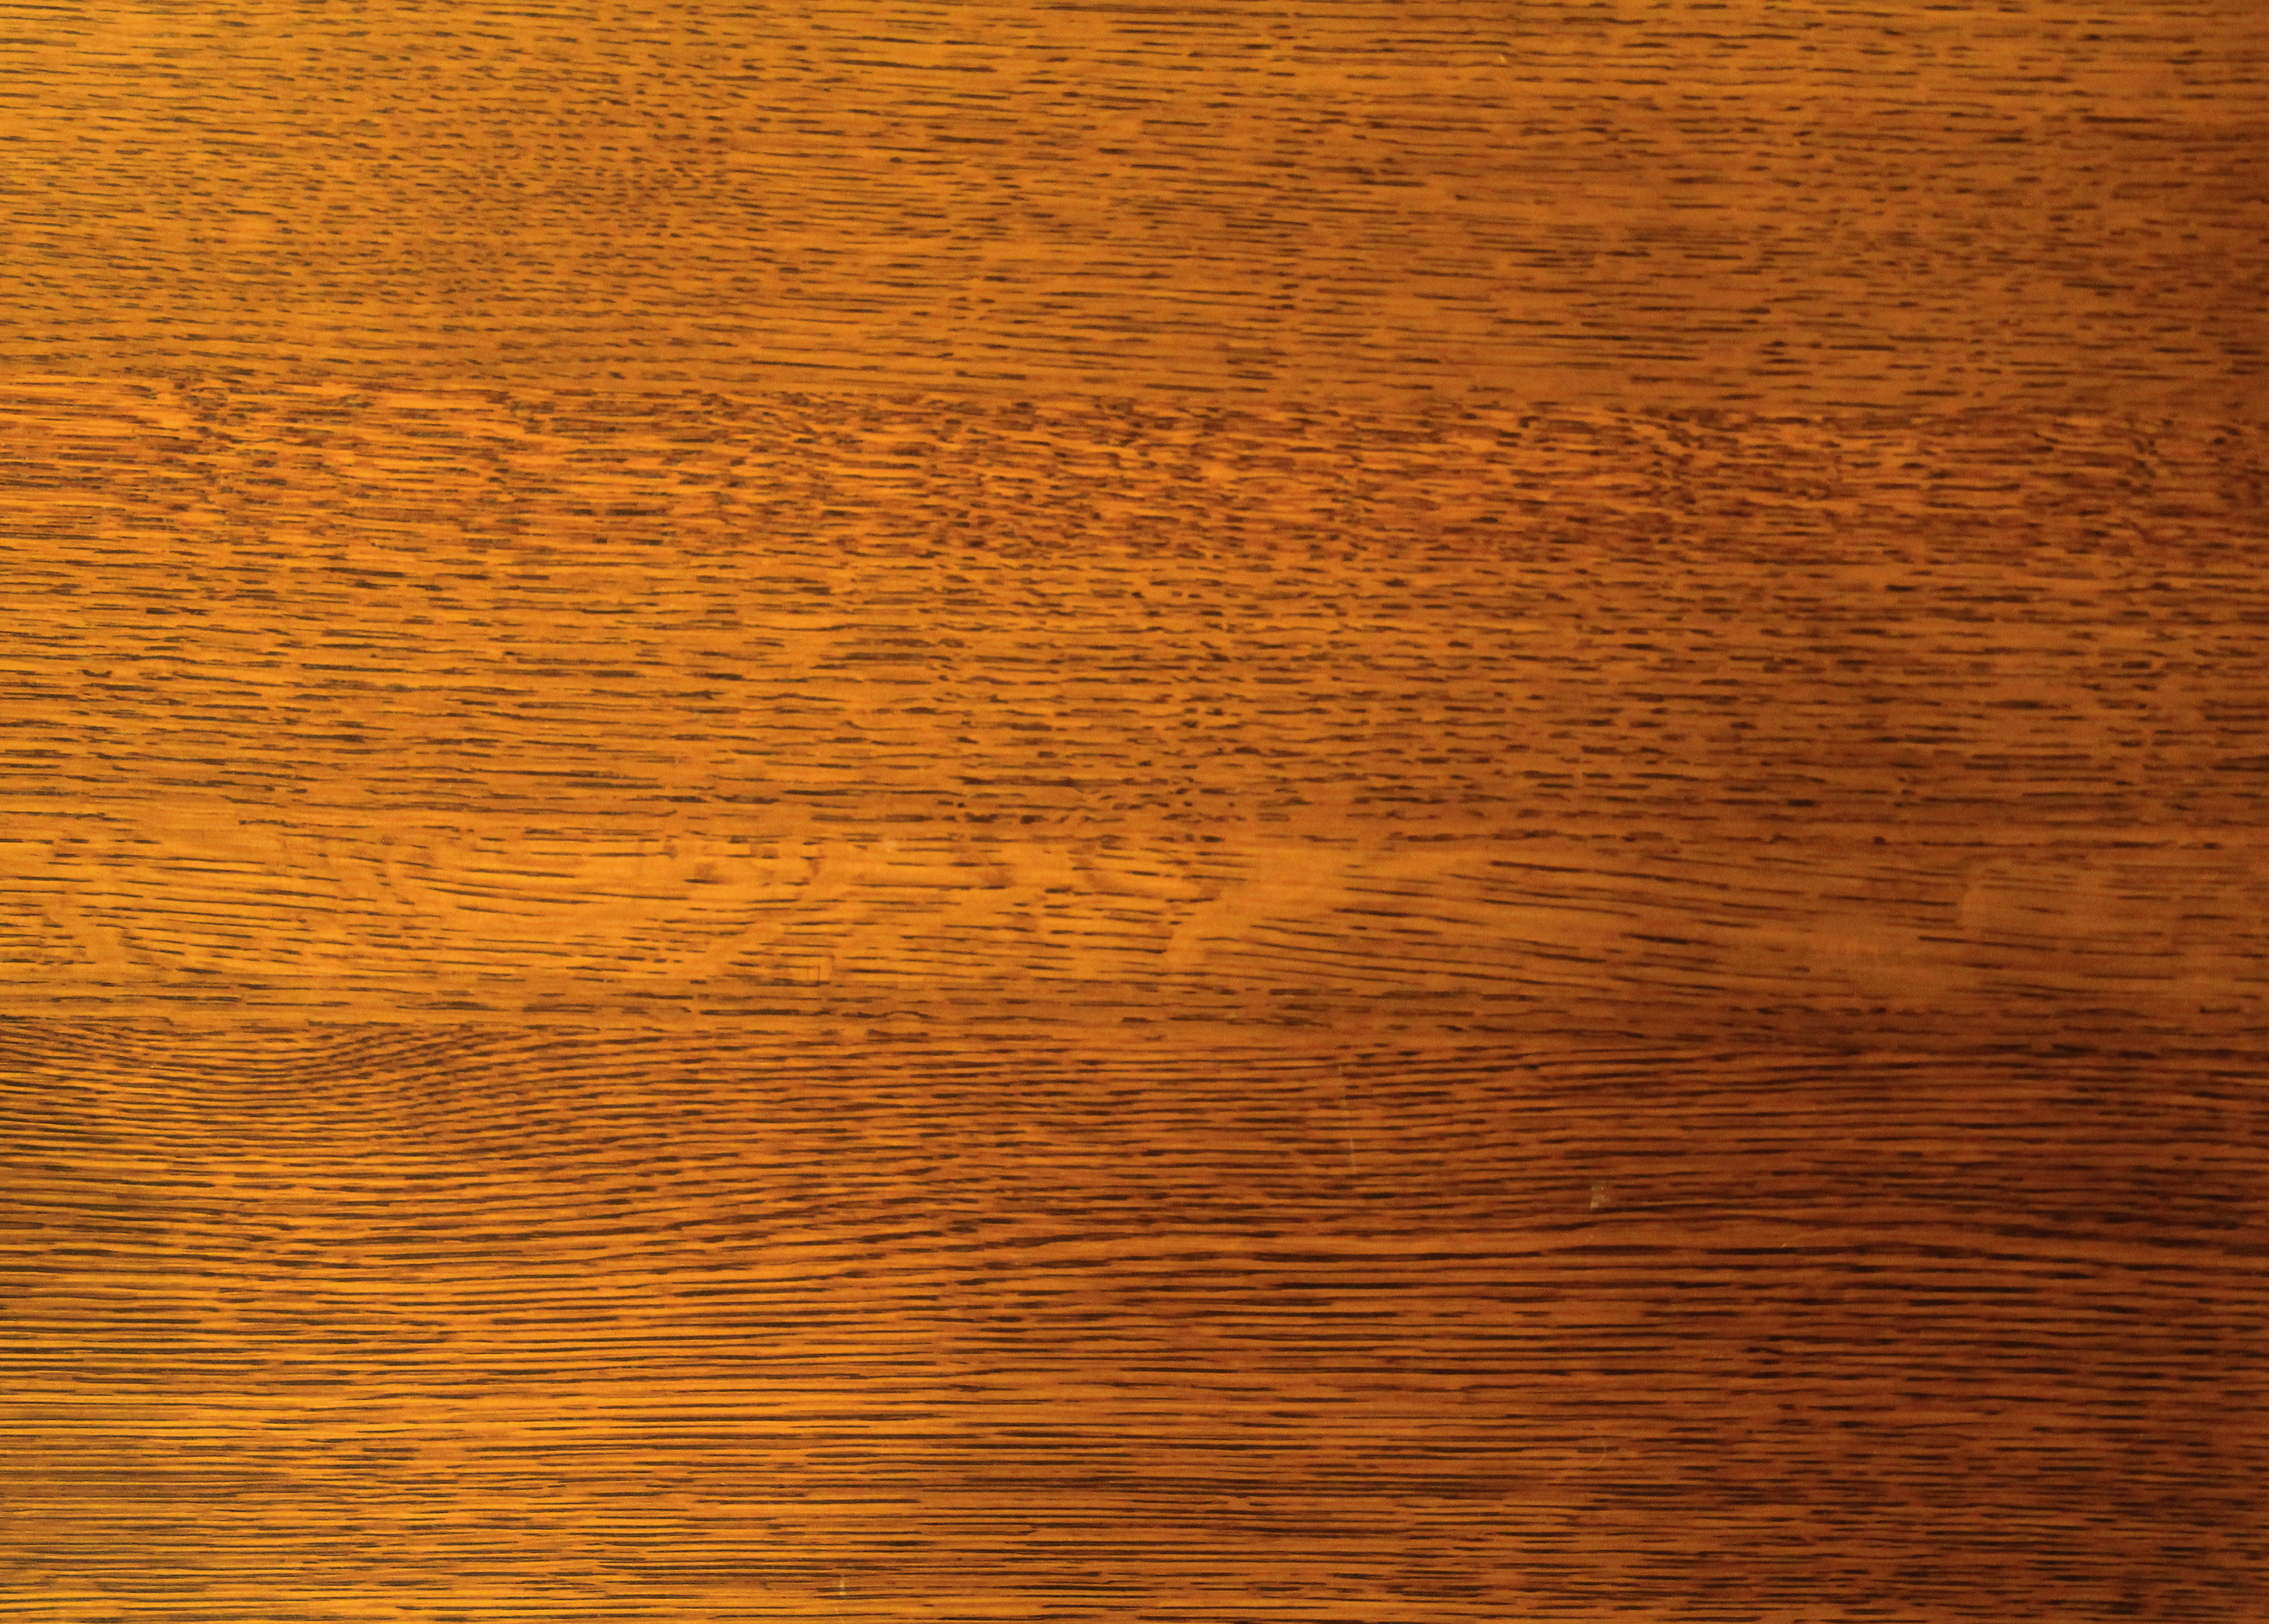

Textures
We used this wooden texture to simulate the classic school chairs we used to use at elementary and junior high-school. The desktop also used this texture, but it seems to look different because of the illumination.
If you pay attention, we choose this texture because we wanted to make a humble classroom scene. In order to accomplish this, a modest floor texture was perfect for the objective.

Slide 9

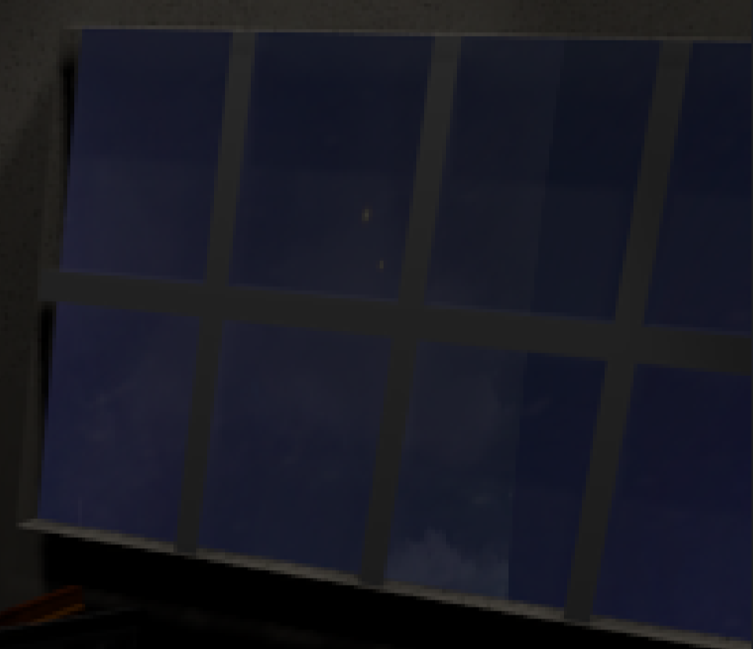
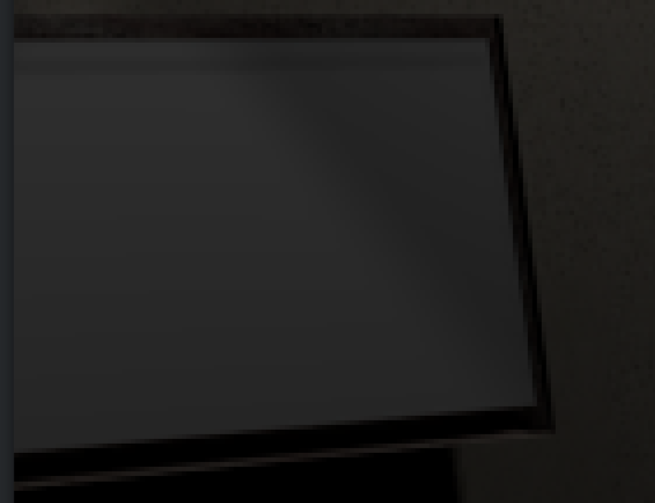
Textures
Same as with the floor, the idea was to create a humble scene of a classroom. So we used a modest plaster wall.
We also created some materials for some objects, such as glass for the windows, and white material for the whiteboard.

Slide 10
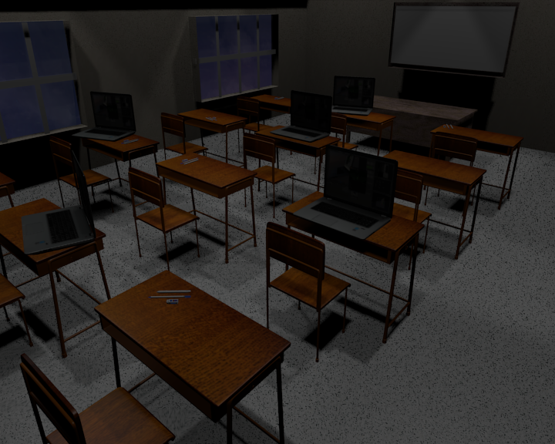
Colour Pallet
Our main focus was to use a dark pallet of colors. The reason: to show a sad illusion.
Even though there is a whiteboard and laptops, we wanted to transmit that this is just a sad illusion wished for a lot of Mexican children that don’t have access to these resources.

Slide 11
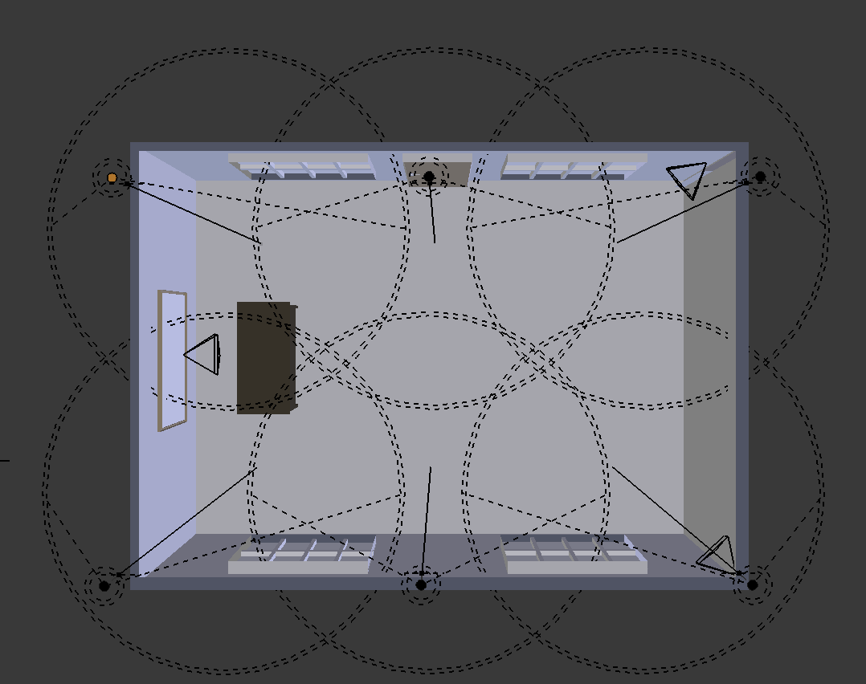
Illumination
Illumination scheme
6 spotlights, Two lines of three lamps.
Characteristics:
Energy: 1.01.
Falloff distance: 15
Z position: 18
We use that light to simulate a dark classroom. Using other resource (illumination) we boosted this sad illusion we aimed for.
Shadows helped simulating the dark tone we needed.

Slide 12
Camera Setup
We have 3 cameras:
Two of them are in the back corners to get an Angle Shot of the classroom to get a view of the two sides of it.
The third one is in the front of the classroom, just behind the desk to simulate the view of the teacher. This is called a Point-of-View Shot.
Focal Length: 35 millimeters
Sensor size: 45

Slide 13
Conclusions

Slide 14
Technical Conclusions
We think we learn new things making the models for our project and we also practiced what we learned through the tutorials and homework.
We use Dropbox to share our Blender project so we needed to be organized to avoid conflicts.
We import some models, so we modified them and added some textures to look nice in our scene.
We had issues with the light to generate shadows and to place the camera in the correct position.
We needed a lot of communication and team work.

Slide 15
Ethical Conclusions
We use other people’s model, so we must be honest and give them credit for their work. We also must check and respect licenses, we cannot use a model or texture that is a paid resource for free, we must pay or find free resources.

Slide 16
Citizenship Conclusions
Our project show us the reality of some (few actually) children, but not every children in Mexico can access to that kind of infrastructure to take classes. We need as citizens, work to offer quality education for everyone. To pay our taxes to be used to build more schools and to buy equipment. We as taxpayers have to ask government to use our money to build a high quality educational system.

Slide 17
Environmental Conclusions
Our classroom has computers and simulate lights, we need to work in green energy production and use solar or wind power, because nowadays we use a lot of electricity and we must reduce our carbon footprint.
A classroom is a place where we are most of the time so we need to reduce our paper and resources waste and our energy consumption to help our planet and to reduce global warning.

Slide 18
References
http://4.bp.blogspot.com/-5xNMmxVjWKg/UA5bNp_0jaI/AAAAAAAAB4s/QXcwBUUPPKw/w1200-h630-p-k-no-nu/Seamless+wall+white+paint+stucco+plaster+texture.jpg
Concrete: https://cloud.blender.org/p/textures/574bfcd4c379cf184a2c9a6d#
Wood: https://cloud.blender.org/p/textures/567800d4c379cf211051a439
Laptop: https://free3d.com/3d-model/notebook-low-poly-version-57341.html
Door Knob & room ideas: https://www.blendswap.com/blends/view/66267

